Slide 1
Med!c_Plus( )
Batch No: 190047
Guided by
Prof.Asish Kumar Dalai
Dept. of CSE
Team Members
1. 18BCD7008 - KATHAL ADITYA RAJENDRA
2. 18BCD7018 - AMANDEEP SHARMA
3. 18BCD7044 - SHARAJ RAJA CHANDRAN
4. 18BEV7017 - SHIVANSHU TRIPATHI
5. 18BEC7045 - RAHUL GANESH REGALLA
6. 18BCN7143 - SK SADDAM HOSSAIN

Slide 2
Agenda
Introduction
Abstract
Module Identification
Architecture Diagram
Equipment Identified
Time Line Chart
References

Slide 3
Abstract
A device that acts as a medical emergency info station which has the ability to call for help, dispense medicine and much-much more. During a medical crisis anyone can access this terminal in order to get information about the patient’s medical history and emergency contacts. With ready first hand knowledge of the patient dealing with his/her medical condition becomes faster and more reliable which is of paramount importance.
In todays world danger lurks around every corner and one can never be too sure of one’s physical health and well being. In order to make the process of dealing with life threatening situation more efficient and reliable our team has come up with the idea of
Medic _Plus .

Slide 4
1. Introduction
Our project aims at serving the mankind to the utmost level. A general problem we face in India is whenever there is a medical emergency somehow the best possible help takes too much time to reach and in some cases the required medication or the proper medicine for that particular emergency situation is not available.
So here we have the solution, our major aim is in developing a database for every citizen of India so that whenever a patient goes to doctor, he should have the proper information about the past medical history of that individual. We highly emphasis on improving the medical facility in India. After the database our next major goal is to setup a dispenser all over the country so that common people can be benefitted from our idea.

Slide 5
2. Module Identification
Software:
Database
App
GUI
Hardware:
Arduino
Raspberry pi
Equipment list:
servo motors
Jumpers
breadboards

Slide 6
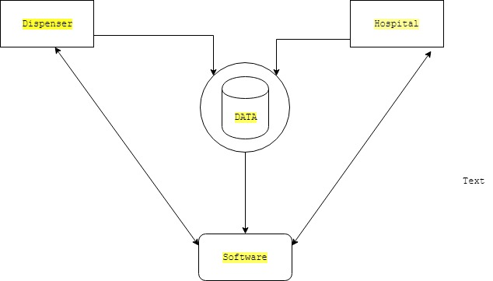
3.Architecture Diagram

Slide 7
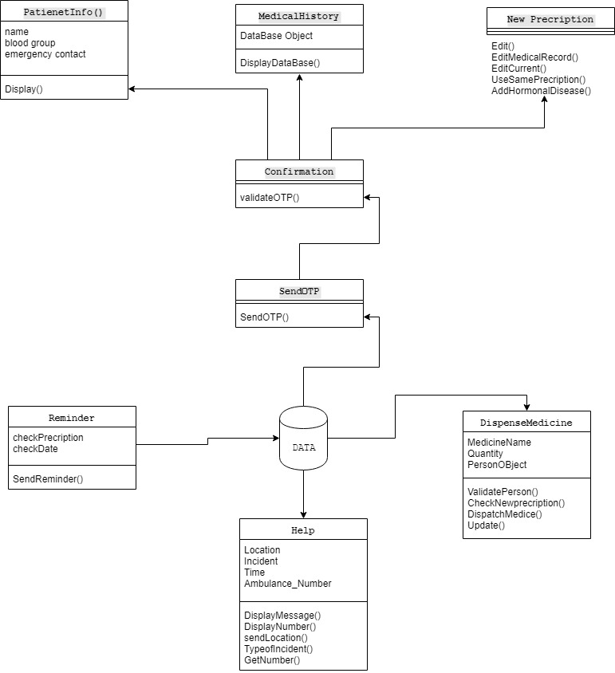

Slide 8
4.Equipment Identified
S.No | Name of Equipment | Quantity | Cost
1 | Arduino Uno | 1 | Rs.450
2. | Raspberry pi | 1 | Rs.3138
3. | Servo motors | 2 | Rs.129
4. | Jumpers | 240 | Rs.6
5. | Breadboard | 2 | Rs.100
Total : Rs.500

Slide 9
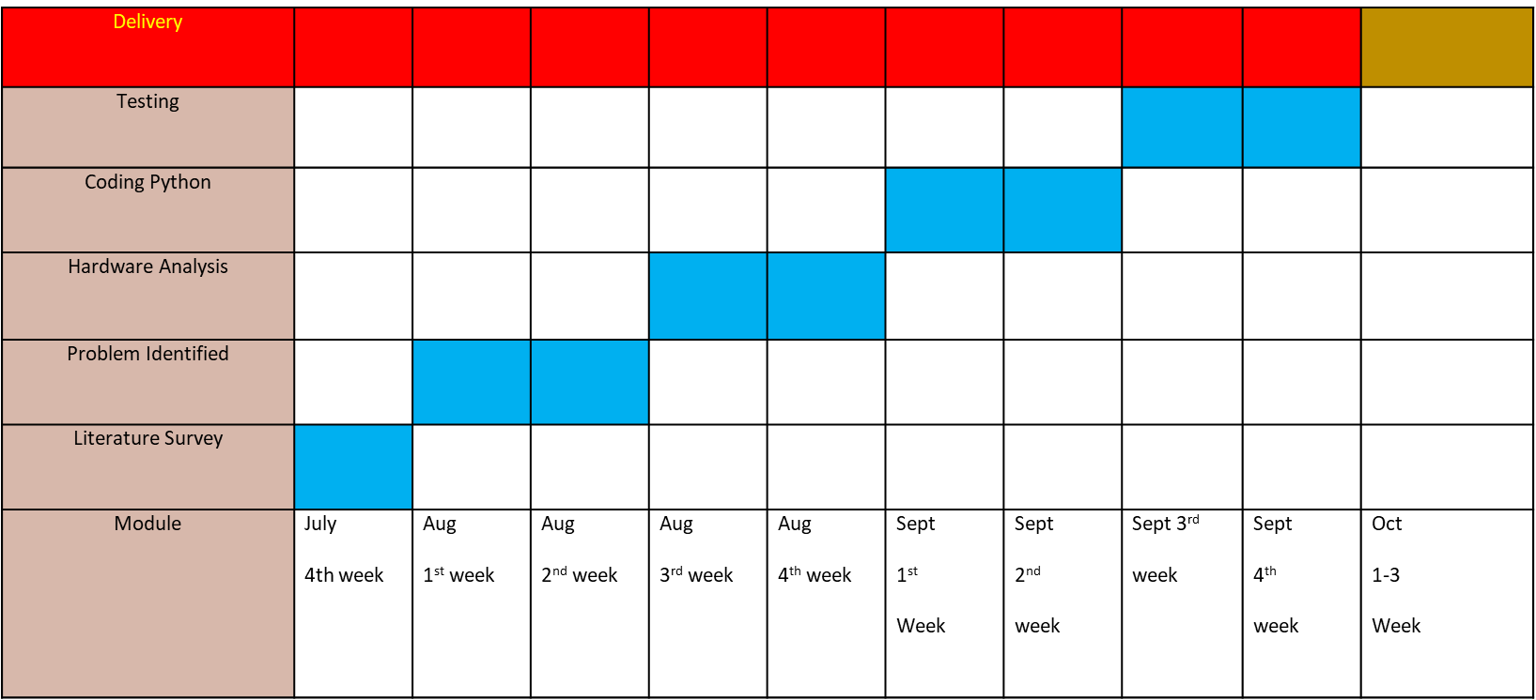
5.Timeline Chart

Slide 10
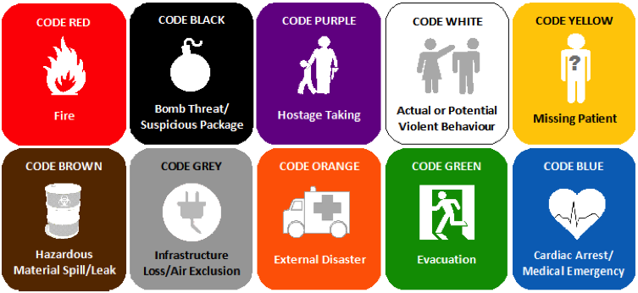
6.References
https://www.amazon.in/dp/B07BHP46Y6/ref=cm_sw_r_wa_apa_i_nEVuDbW62S1GA
https://www.amazon.in/dp/B015C7SC5U/ref=cm_sw_r_wa_apa_i_mFVuDbEN9BY3K
https://www.amazon.in/dp/B07Q1HT9R5/ref=cm_sw_r_wa_apa_i_PGVuDb4WM77AN
https://www.amazon.in/dp/B071VQLQQQ/ref=cm_sw_r_wa_apa_i_eIVuDbQCKRB3H

